Slide 1
EECT 112 LAB NOTEBOOK
Josiah Abel
Fall 2014
Instructor: Louis Toth
Partner/Assistant: Dakota Johnson

Slide 2
TABLE OF CONTENTS
LAB # | LAB TITLE | SLIDE LOCATION
LAB 1 | AND, OR Gates | (3-12)
LAB 2 | Alternative NAND | (13-25)
LAB 3 | Car Alarm (Midterm) | (26-33)
LAB 4 | Binary Counter | (34-42)
LAB 5 | Basic Stamp 1LED Flasher | (43-48)
LAB 6 | Basic Stamp 2 Temp Sensor/Heater | (49-56)

Slide 3
LAB 1: AND, OR Gates

Slide 4
Equipment:
Breadboard – NIELVIS II+ , SN: 14C6E29
Digital Multimeter(DMM) – GWINSTEK GDM-3245, SN: CL860334
AND Gate – chip number: 74LS08D
OR Gate – chip number: 74LS32D
Miscellaneous Wiring
Objective:
To Demonstrate and become familiar with wiring a digital circuit, specifically one using an AND gate or an OR gate.

Slide 5
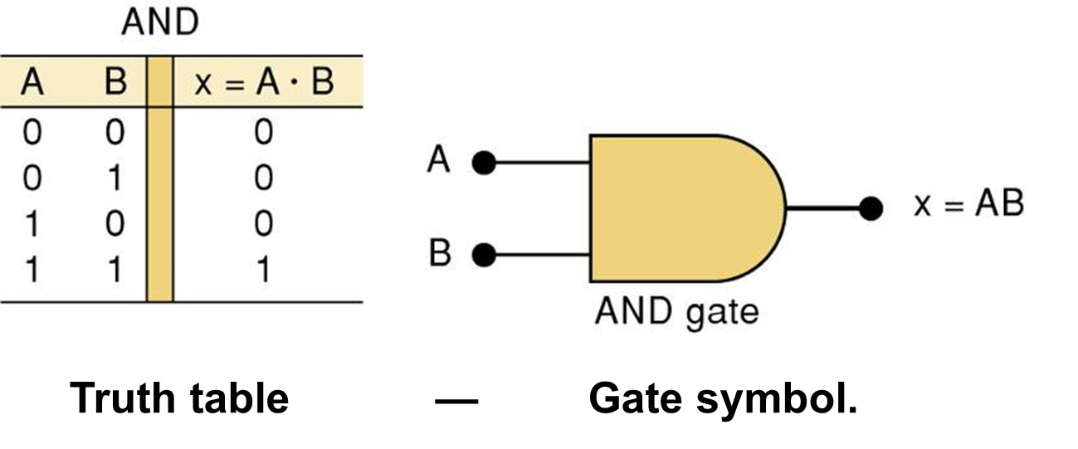
AND GATE AND TRUTH TABLE:
1 = Logic True, 0 = Logic False
TRUTH TABLE:
A truth table demonstrates what the output of a system will be for every possible input combination.
AND GATE:
A and B represent the inputs to the gate. In an AND gate, ALL of the inputs must have a logic of 1 to trigger a high for the whole gate.

Slide 6
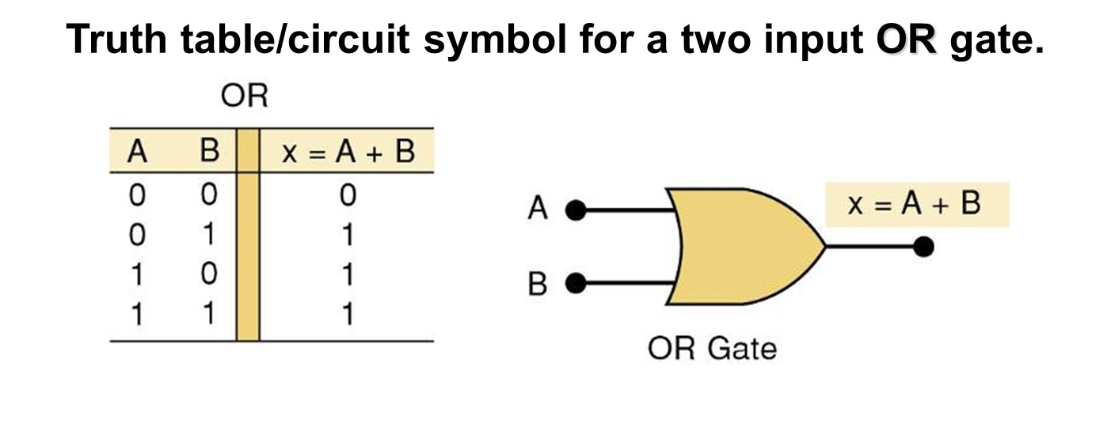
OR Gate and Truth Table:
1 = Logic True, 0 = Logic False
TRUTH TABLE:
A truth table demonstrates what the output of a system will be for every possible input combination.
OR GATE:
A and B represent the inputs to the gate. In an OR gate, only one of the inputs must have a logic of 1 to trigger a high for the whole gate.

Slide 7
PROCEDURE:
A Multisim 13.0 schematic was constructed
Circuits were built in the lab to confirm operation of AND & OR gates using Elvis II+ proto boards.
Information to hook up the chips was found online and the datasheets were recorded
Also took pictures of the circuit when LED is ON and OFF

Slide 8
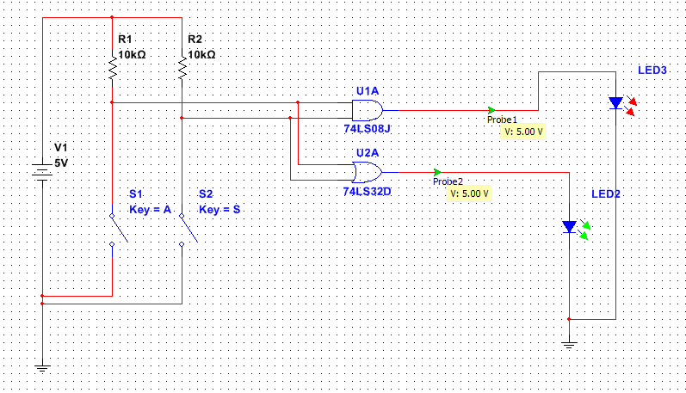
LAYOUT / SETUP OF BREADBOARD:
OR gate
AND gate
Resistors
Input A
Input B

Slide 9
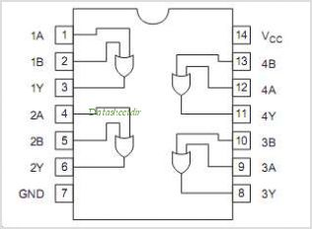
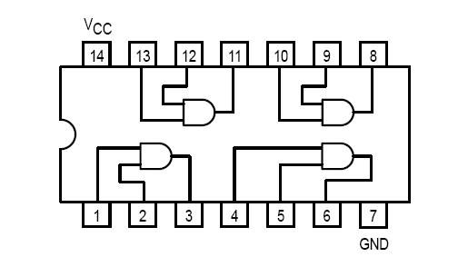
PINOUTS FOR AND/OR GATES:
A Pinout is a diagram which displays each pin’s function on a logic chip
OR GATE
POWER
POWER
AND GATE
GROUND

Slide 10
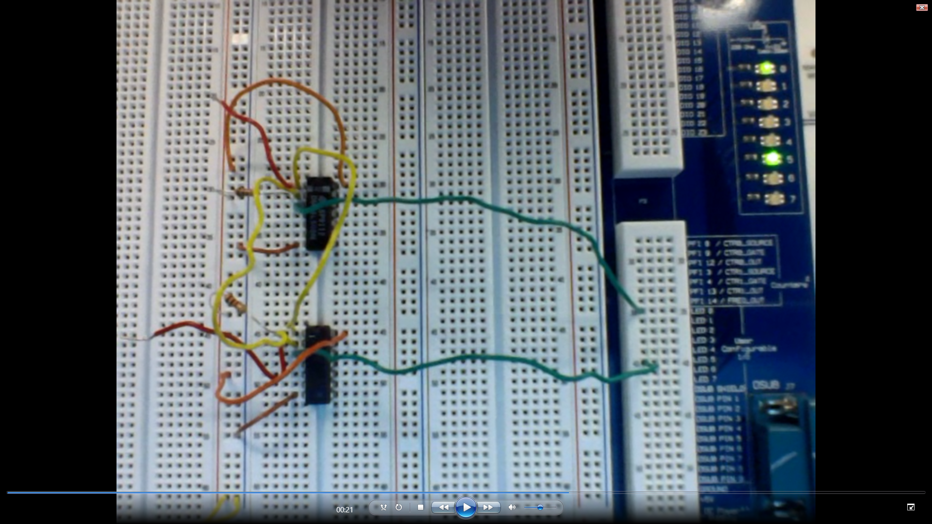
RESULT LEDS on:
LEDS
AND switch
AND GATE
RESISTORS
OR switch
OR GATE

Slide 11
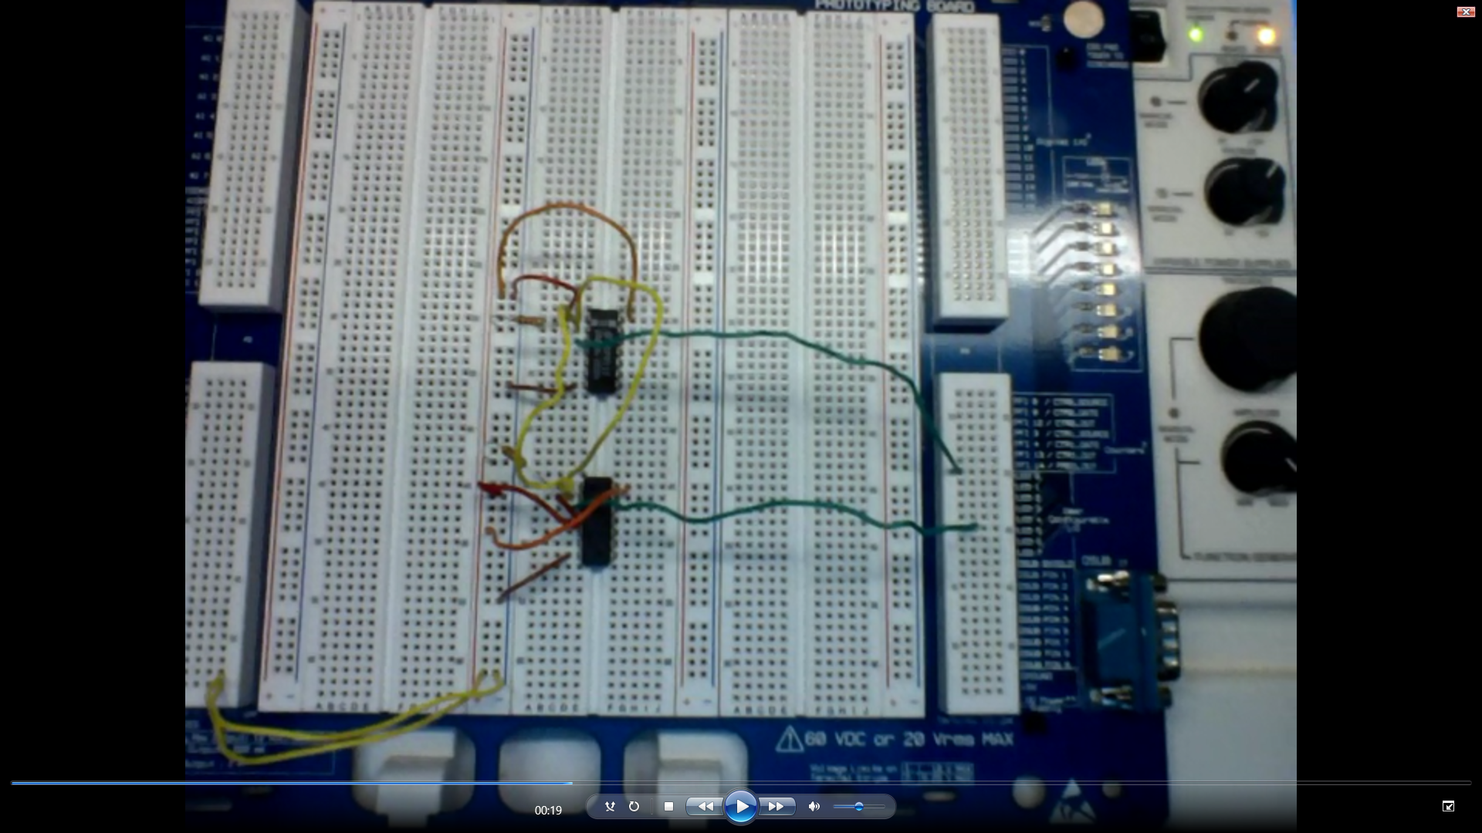
RESULT LED OFF:
LEDS
AND switch
AND GATE
RESISTORS
OR switch
OR GATE

Slide 12
CONCLUSION:
After the circuits for both AND & OR gates had been wired they were tested and found to be true to the Multisim 13.0 Schematic.

Slide 13
LAB # 2: ALTERNATE nand

Slide 14
Equipment:
Breadboard – NIELVIS II+ , SN: 1677D1E
Digital Multimeter (DMM) – GWINSTEK GDM-8245, SN: CL860332
AND Gate – chip number: 74LS08D
OR Gate – chip number: 74LS32D
NOT Gate – chip number: 74LS04D
NAND Gate – chip number: 74LS00D
Miscellaneous Wiring
Objective:
T0 simplify a digital circuit by using less chips and by using the Boolean operation of inverting both inputs and outputs to change the gates function.

Slide 15
AND GATE AND TRUTH TABLE:
1 = Logic True, 0 = Logic False
TRUTH TABLE:
A truth table demonstrates what the output of a system will be for every possible input combination.
AND GATE:
A and B represent the inputs to the gate. In an AND gate, ALL of the inputs must have a logic of 1 to trigger a high for the whole gate.

Slide 16
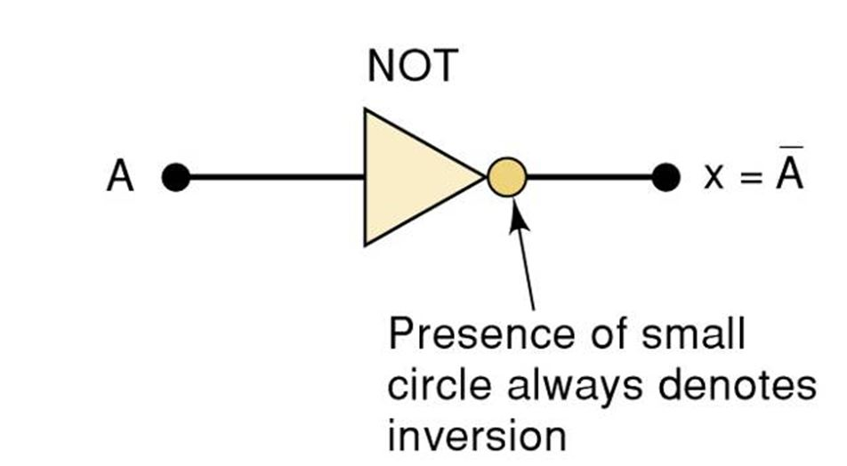
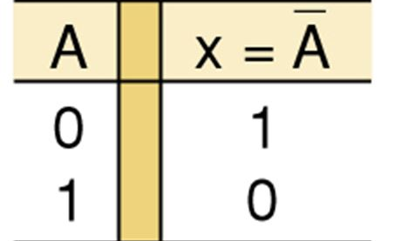
NOT GATE AND TRUTH TABLE:
1 = Logic True, 0 = Logic False
TRUTH TABLE:
A truth table demonstrates what the output of a system will be for every possible input combination.
NOT GATE:
A represents the input to the gate. In an NOT gate, ALL of the inputs That have a logic of 1 have an output of 0. ALL inputs that have an input of 0 have an output of 1. This gate is also called an inverter.

Slide 17
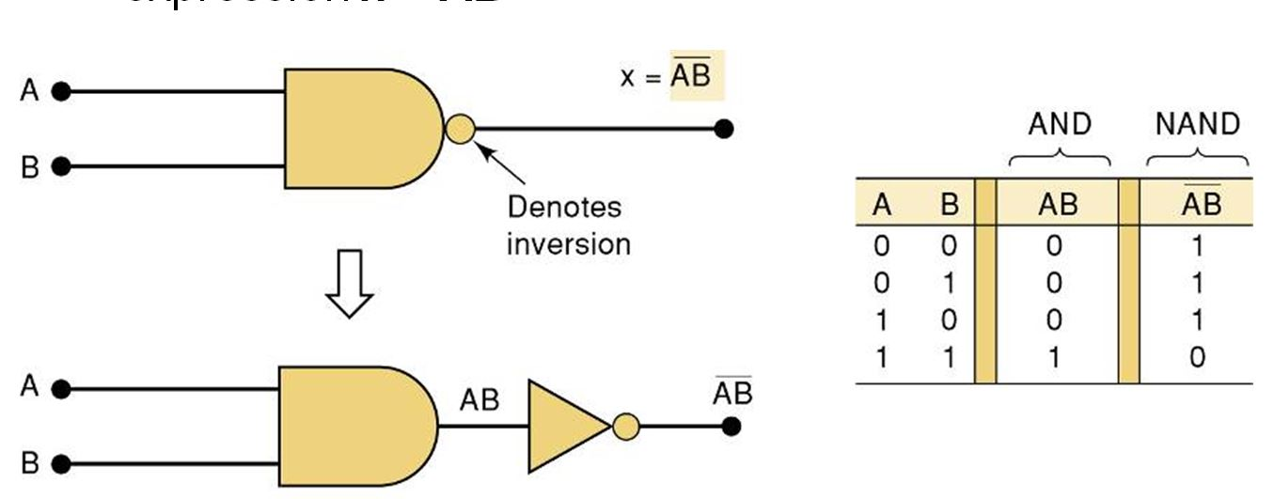
NAND Gate and Truth Table:
1 = Logic True, 0 = Logic False
TRUTH TABLE:
A truth table demonstrates what the output of a system will be for every possible input combination.
NAND GATE:
A and B represent the inputs to the gate. In an NAND gate, both of the inputs must have a logic of 0 to trigger a high for the whole gate. Because the NAND function inverts the inputs.

Slide 18
OR Gate and Truth Table:
1 = Logic True, 0 = Logic False
TRUTH TABLE:
A truth table demonstrates what the output of a system will be for every possible input combination.
OR GATE:
A and B represent the inputs to the gate. In an OR gate, only one of the inputs must have a logic of 1 to trigger a high for the whole gate.

Slide 19
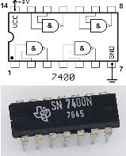
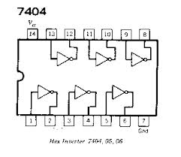
NAND, NOT PINOUTS:
NAND CHIP
NOT CHIP
POWER
NAND GATE
NOT GATE
GROUND

Slide 20
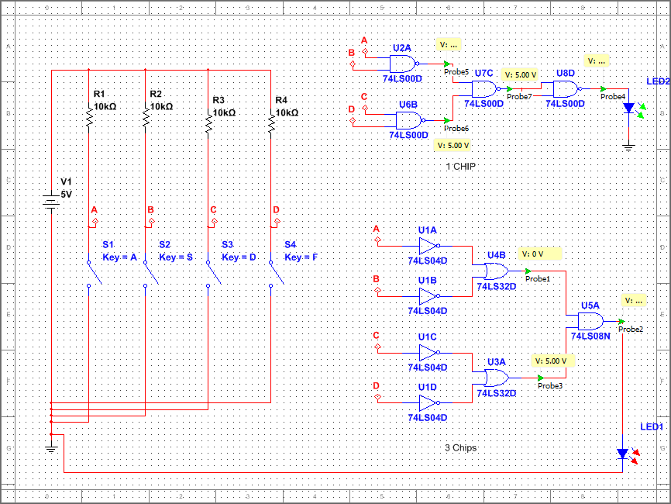
MULTISIM 13.0 SCHEMATIC:
NAND GATE
INPUT SWITCHES
OR GATE
AND GATE
NOT GATE

Slide 21
PROCEDURE:
Constructed a Circuit containing NOT, OR, & AND Gates creating it so that the inputs to two OR gates were inverted then their outputs were wired into the inputs of an AND gate. This assembly was wired to an LED On the Proto Board.
Another circuit was constructed with the same output using just NAND gates.
Voltage of the circuit was measured when LEDs were On.
Voltage Was measured when the LEDs were off.
Voltage was measured when the LEDs were disconnected from the circuit.

Slide 22
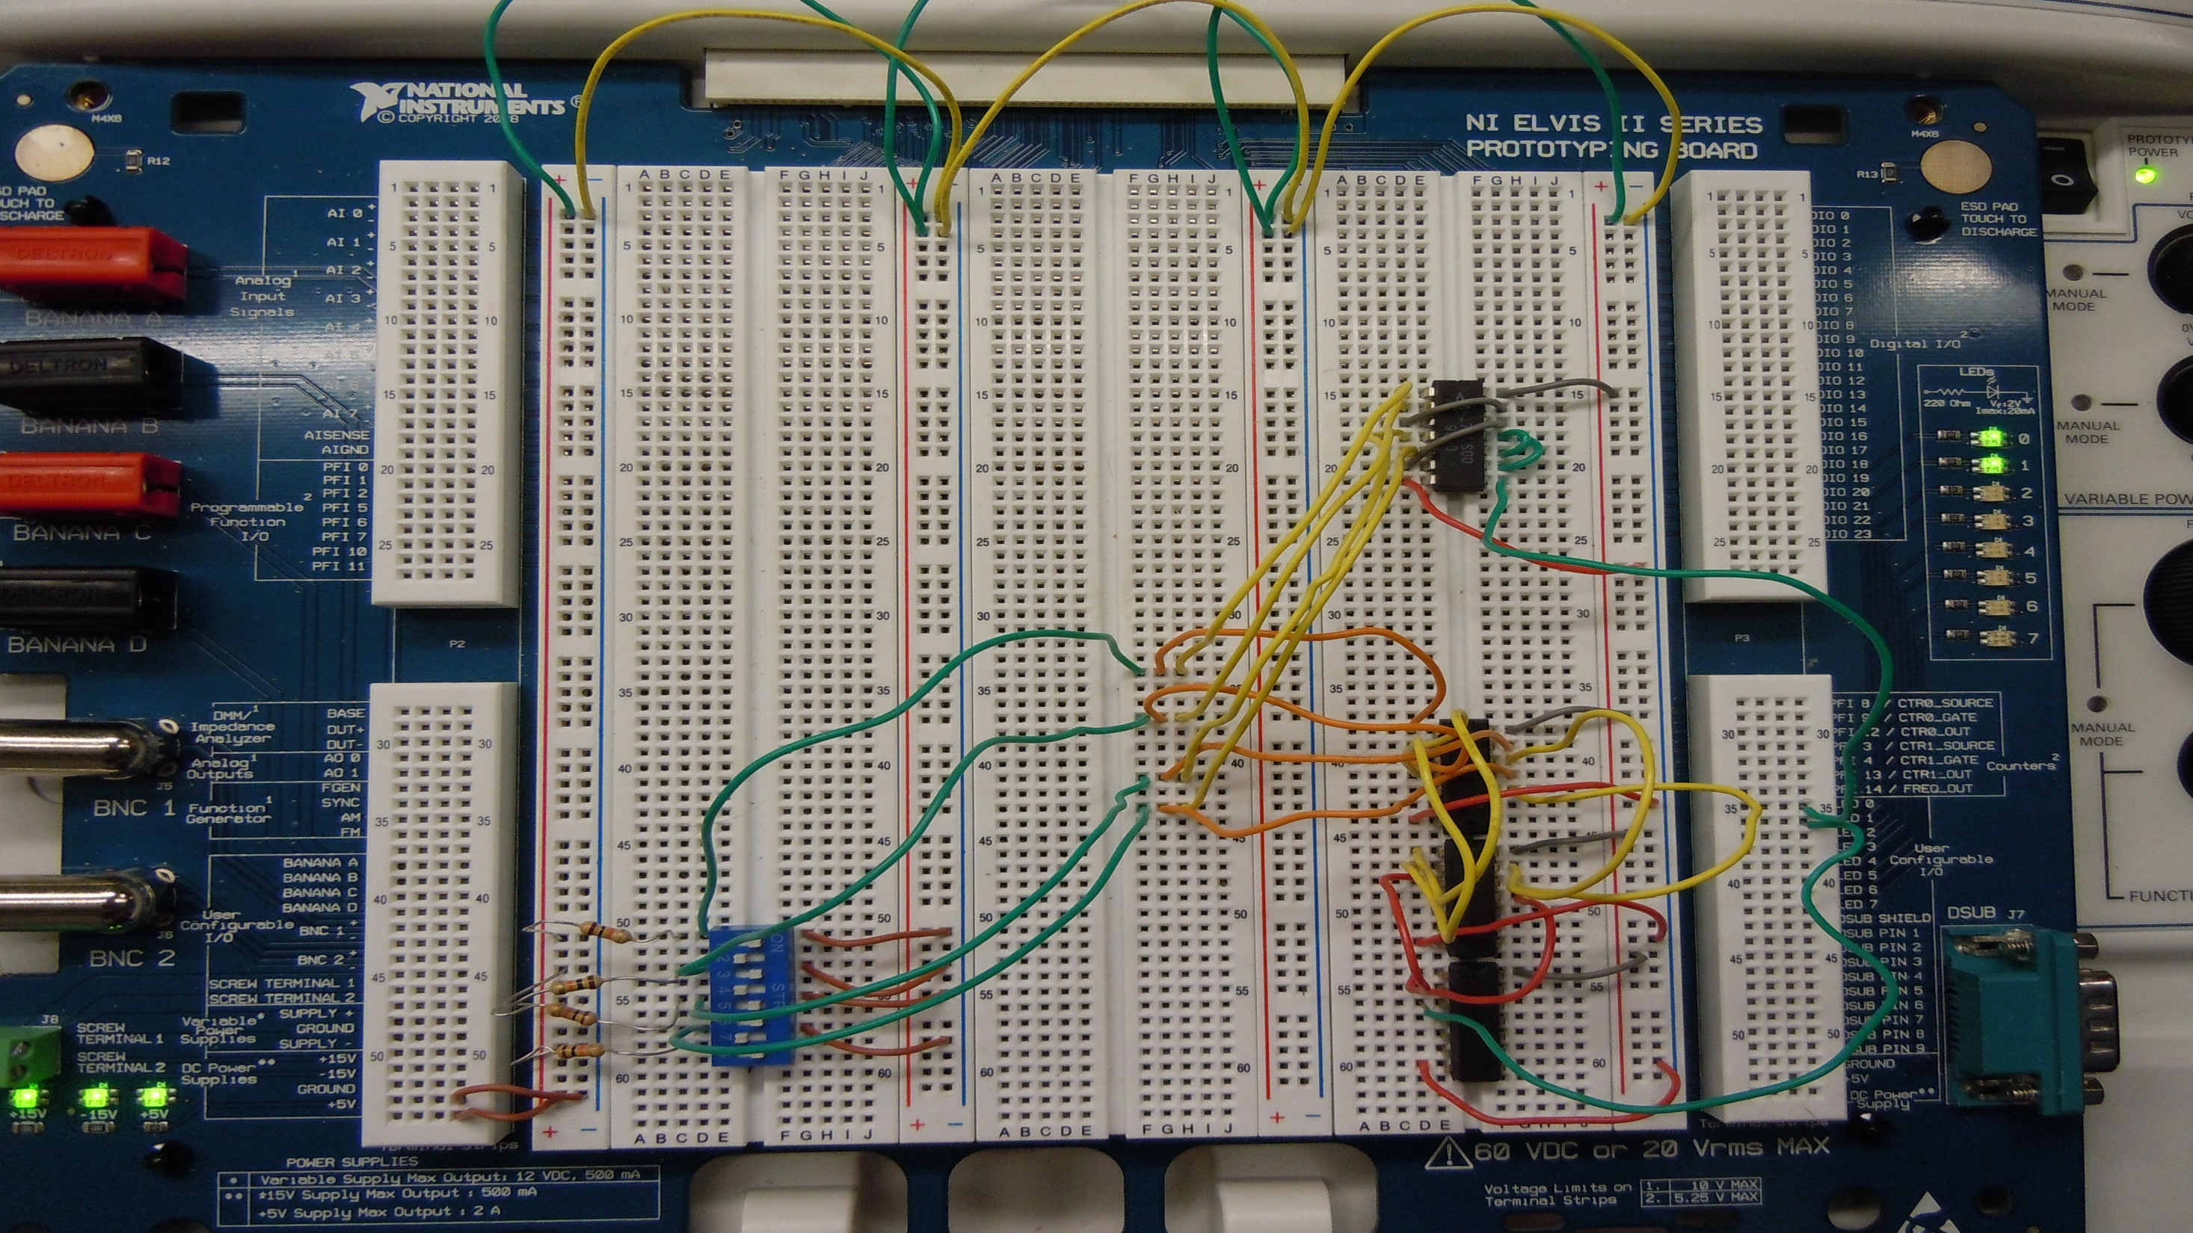
NAND GATES
NOT GATE
LED INPUTS
RESISTORS
INPUT SWITCHES
OR GATE
AND GATE

Slide 23

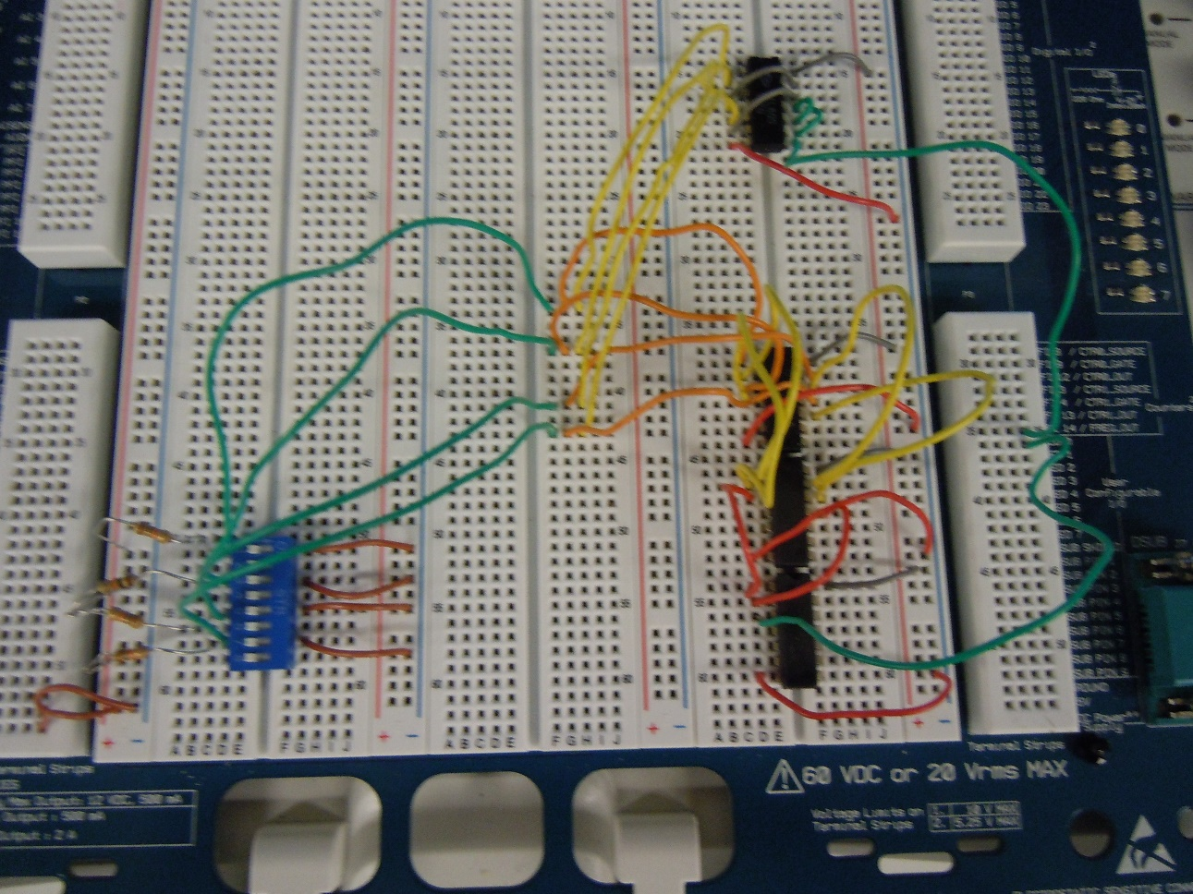
LED ON and Off:
LED ON
LED OFF

Slide 24
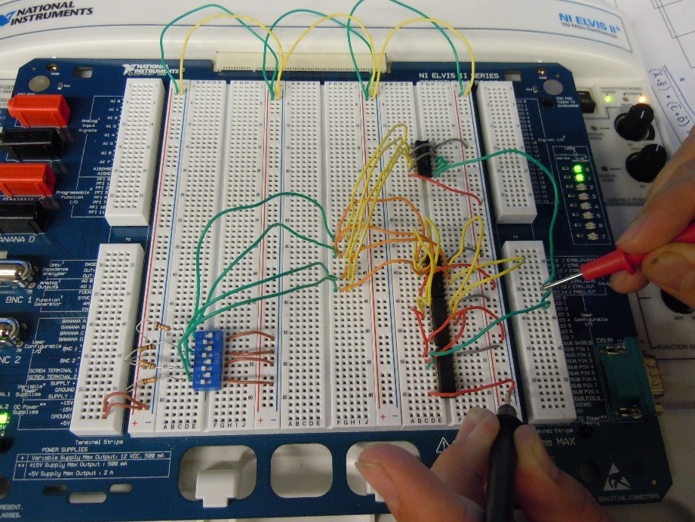
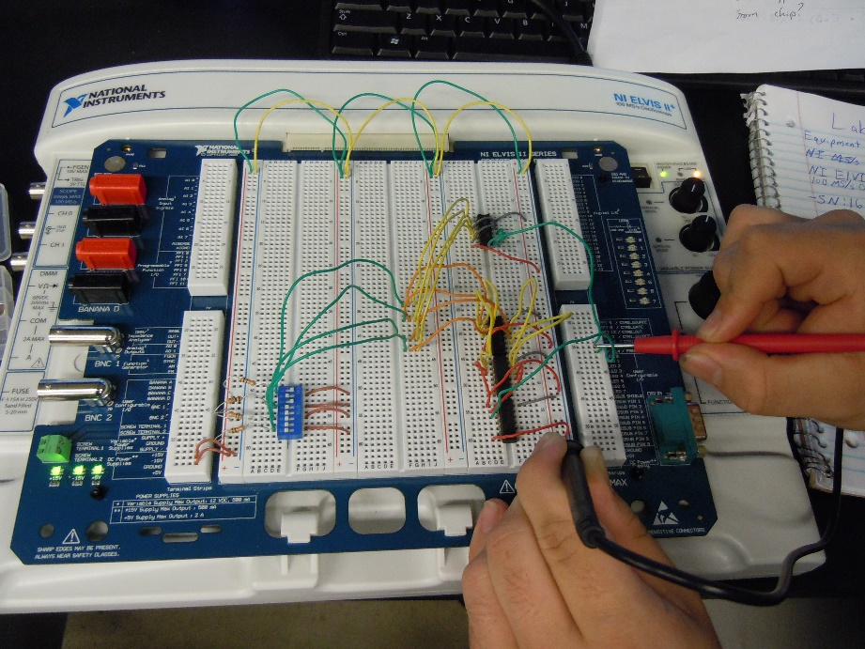
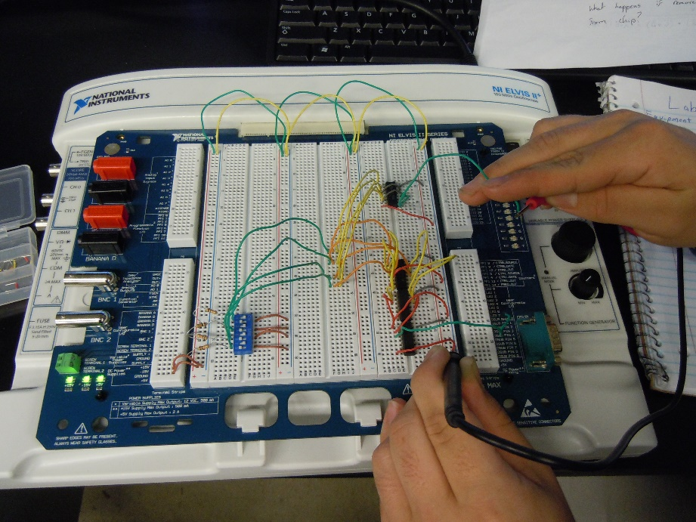
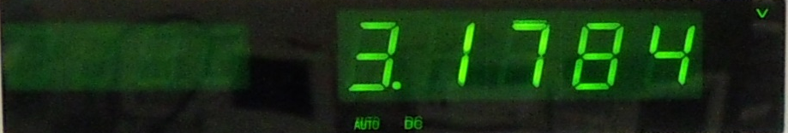
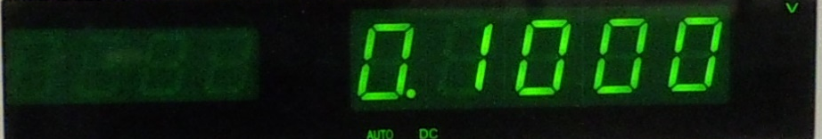
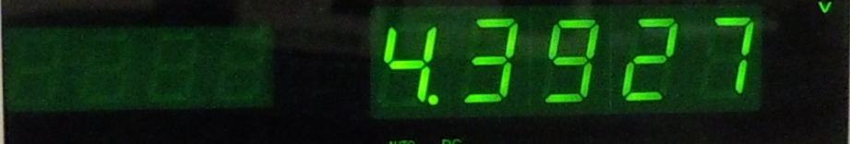
Digital Multi meter voltage measurements:
LED ON
VOLT: 3.1784
LED OFF
VOLT: 0.1000
LED DISCONNECTED
VOLT: 4.3927

Slide 25
CONCLUSION:
By using the property of inverting inputs and outputs of a gate, it reverses the gate’s function. (AND becomes OR)
This principle may be used to reduce the number of chips utilized within a circuit.
When the voltage measurements were taken the difference between when the LED was off and on is explained by the fact that the power is being routed through all the components for LED on and it is being routed to ground for LED off.
When the LEDs were removed the voltage reading was higher because it had less resistance traveling through the circuits.

Slide 26
LAB # 3:CAR ALARM (Midterm)

Slide 27
Equipment:
Multisim 13.0 computer program
Breadboard – NIELVIS II+ , SN: 1677D1E
2 AND Gates – chip number 74ls08D
2 OR Gates – chip number 74ls32D
1 NOT Gate – chip number 74ls04D
3 10k Resistors
Assorted Wiring
OBJECTIVE:
To design the logic for a "Black Box“ of unknown circuitry. To use the given input and output requirements and recreate this circuit from start to finish.

Slide 28
PROCEDURE:
DESCRIPTION
the stated requirements concerned a car alarm. there are three input variables, the car's driver's side front door, the headlights and the ignition, all of which were set to active low meaning that they gave a logic of 1 when a switch toggled to ground. when the door was opened and either the lights or the ignition are on, a gentle beeping car alarm will sound to indicate to the driver that they must close the door before driving or shut the lights or ignition off before getting out of the vehicle. the same alarm will trigger if the ignition is turned off while the headlights remain on.

Slide 29
PROCEDURE Continued:
First A truth table was created.
The Boolean Algebra expression was found and simplified
Multisim 13.0 computer program was used to construct a working virtual circuit.
Then the circuit was built and demonstrated in the lab.

Slide 30
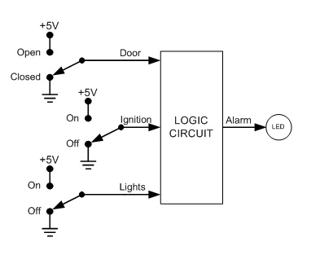
Diagram of project:
The Goal was to create a simplified circuit that would fulfill the necessary requirements to trigger the alarm.

Slide 31
Truth Table
1 = Logic True, 0 = Logic False = Not
INPUT DOOR (D) | INPUT HEADLIGHTS (L) | INPUT IGNITION (I) | OUTPUT ALARM
0 | 0 | 0 | 0
0 | 0 | 1 | 0
0 | 1 | 0 | 1
0 | 1 | 1 | 0
1 | 0 | 0 | 0
1 | 0 | 1 | 1
1 | 1 | 0 | 1
1 | 1 | 1 | 1
The Boolean equation derived from the table is: (L)(I)(D)+(D)(I)(L)+(D)(I)(L)+(D)(I)(L)
Using DeMorgen’s Theorems, the expression can Be simplified to the equation: (I)(D) + L(I)

Slide 32
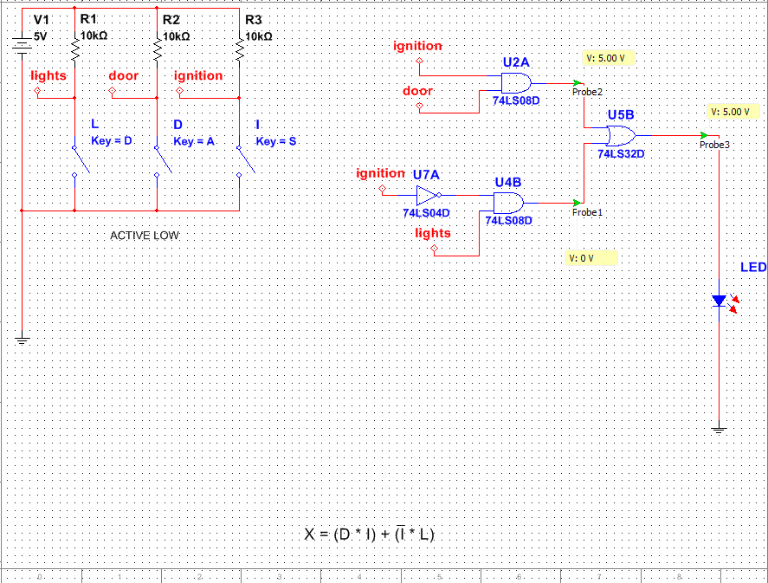
MULTISIM 13.0 DIAGRAM:
NOT Gate
AND Gates
Activator switches
L = lights, D = door
I = ignition
OR Gate

Slide 33
CONCLUSION:
The Circuitry designed fulfilled the requirements for the Car Alarm outlined in the Procedure. By following the Procedure from start to finish an ideal logic circuit could be created.
When the door was opened while the lights or ignition were engaged the LED lit up to signal that the alarm was sounding.
When the ignition was turned off while the headlights were on the LED lit up again to indicate that the alarm was sounding.

Slide 34
LAB # 4: Binary counter

Slide 35
EQUIPMENT:
NI ELVIS II+ , SN: 1677D3B
Function Generator computer program, NI_ELVISmx
Tektronix TDS 220, Two channel, (Digital real-time Oscilloscope), SN: B068379
4-Bit Ripple Counter chip – 74ls93P
BCD To 7 Segment Decoder chip – 74ls48P
Man 74 – 7 segment display
1 10k resistor
Assorted wiring
OBJECTIVE: To Use NI Elvis II+ to build 4-bit binary counter with hex 7-segment display that counts from zero to F in the Hexadecimal system (0-15).

Slide 36
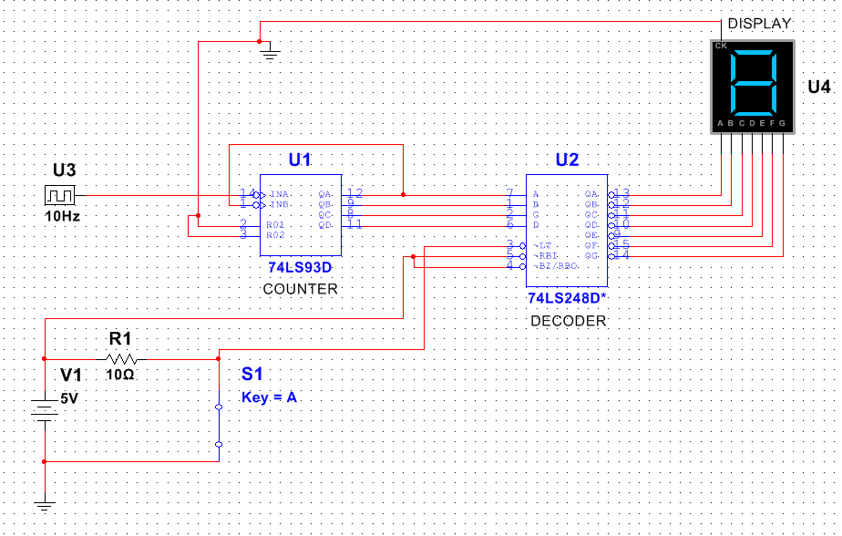
PROCEDURE:
Multisim 13.0 was utilized to create a Working schematic
Digital clock
Man 74, 7 seg. display
RESET

Slide 37
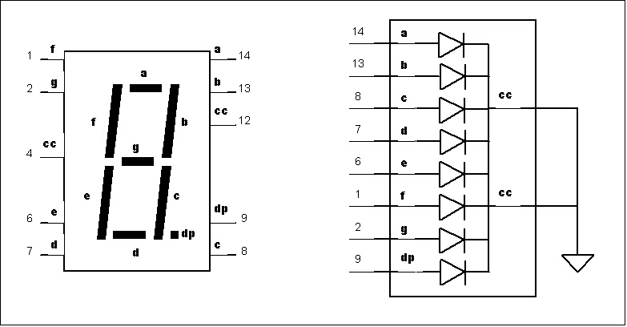
PROCEDURE Continued:
The pinout for the Man 74 7 segment display was researched so that the proper output wires from the Decoder could be inserted to create the proper number on the display for the current count.
Example: by applying power to a, b, c, d, e and f the number 0 would appear on the display.
Example: by applying power to a, b, and c the number 7 would appear on the display.

Slide 38
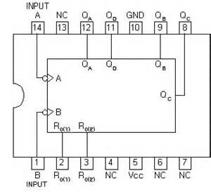
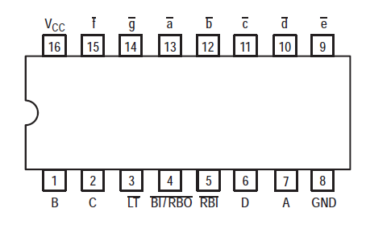
PINOUTS, Counter and decoder:
COUNTER CHIP
DECODER CHIP
Count Variable Outputs
Output Power to 7-Segment Display
GROUND
POWER
Counter Inputs
Clock INPUTS

Slide 39
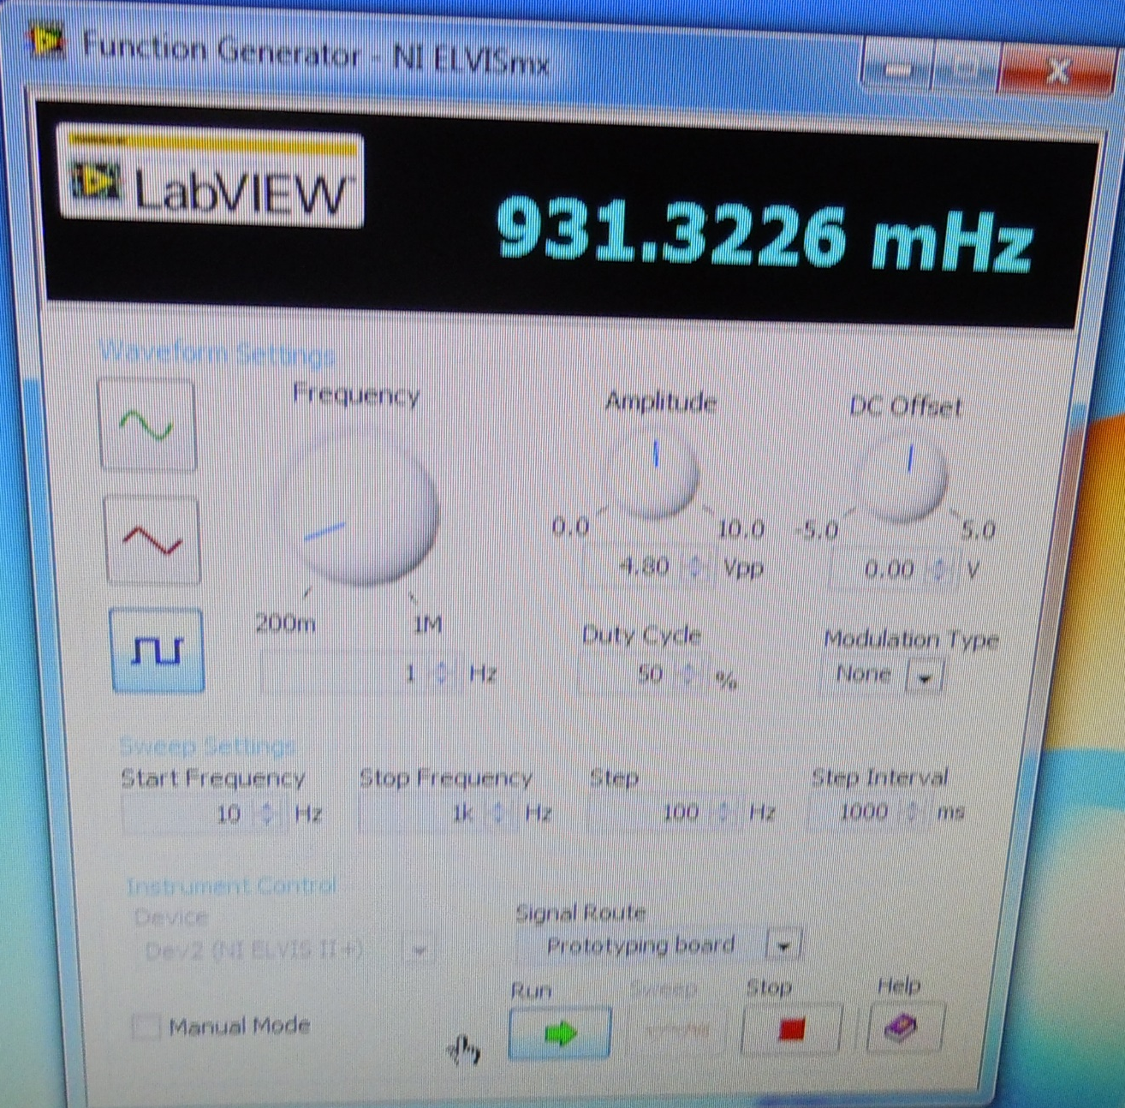
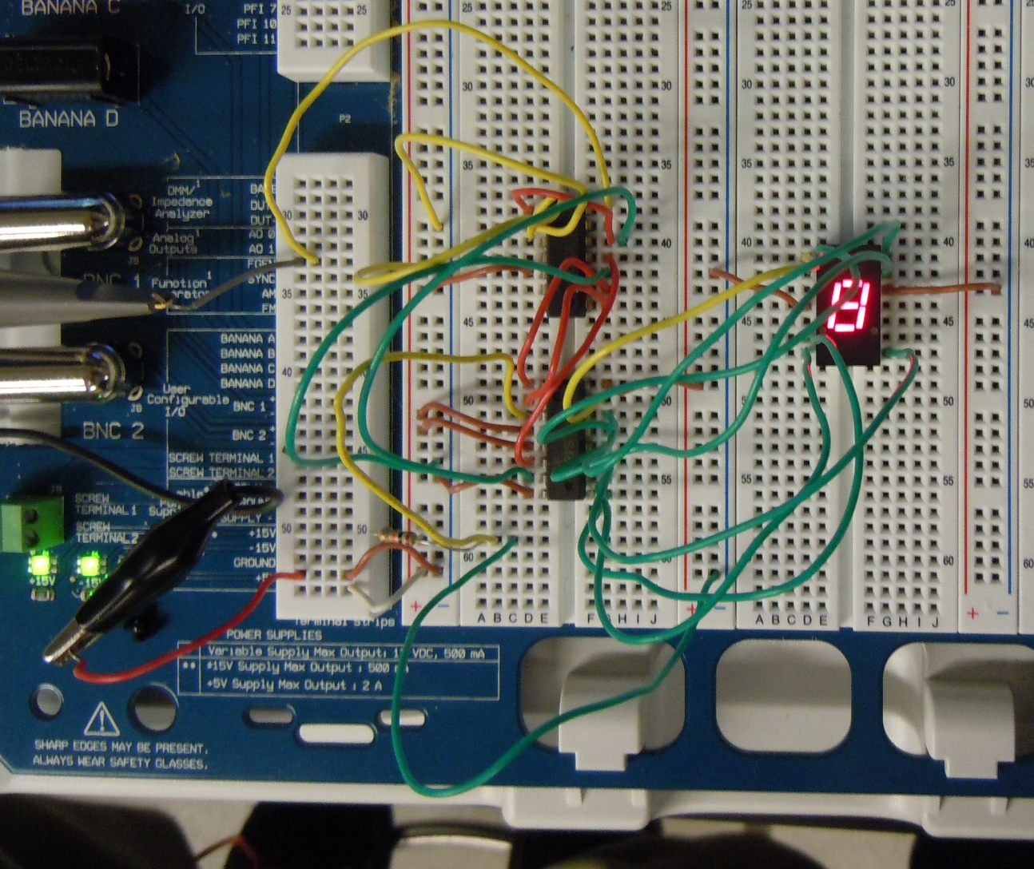
Setup:
FUNCTION GENERATOR COMPUTER PROGRAM
The Function Generator was plugged into the Proto board to create a Clock that the Counter Chip could interpret.
DECODER
CHIP
COUNTER
CHIP
7 – SEGMENT
DISPLAY

Slide 40
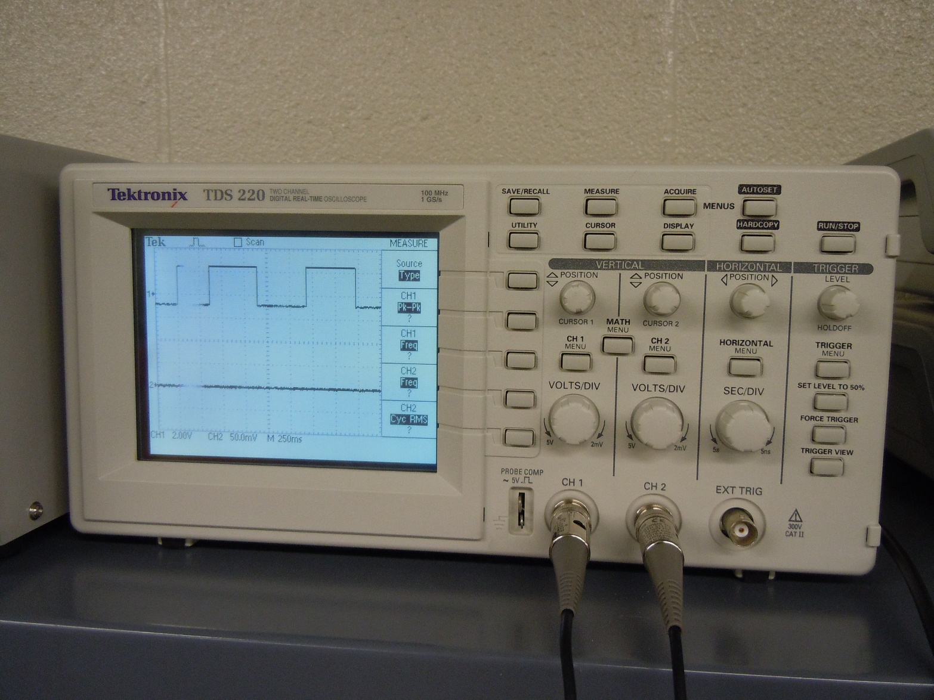
Physical representation:
The Clock created by the function generator program was given a physical display using the Tektronix TDS 220, Two channel, (Digital real-time Oscilloscope). This way when the clock was changed to a faster or slower period the Clock could be observed over channel 1.
OBSERVABLE
COUNT

Slide 41
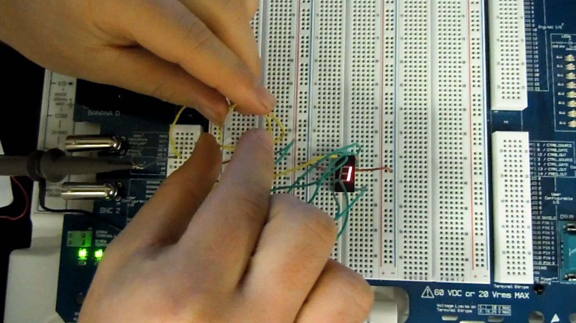
RESULT AFTER wiring:
RECOGNIZABLE NUMBERS:
-0
-1
-3
-4
-5
-7
-8
-9

Slide 42
CONCLUSION:
By Using The new 4-Bit Ripple Counter chip and the BCD To 7 Segment Decoder chip it was possible to construct a Counting circuit with a 7-segment display
The Count in Multisim 13.0 was programmable, therefore you could modify exactly how each number in the count was displayed. When it was physically represented on the Proto Board the numbers displayed skipped around because of mismatched programing between the Decoder and the Counter chips.

Slide 43
lab # 5: Basic Stamp 1 Led flasher

Slide 44
EQUIPMENT:
Industrial Control Student Workbook Version 1.1
One red LED
2 220 ohm resistors
1 10k ohm resistor
1 dipswitch (wire)
BASICSTAMP II device
BASICSTAMP program
Miscellaneous Wiring
OBJECTIVE:
To Program and build a simple circuit using the BASICSTAMP computer program and by wiring a BASICSTAMP II board.

Slide 45
PROCEDURE:
In the Industrial Control Student Workbook Version 1.1, Experiment #1, Exercise #2, LED Blinking Circuit, a simple circuit was laid out that contained a single LED output and Pushbutton input. A program was designed for when the pushbutton is pressed, the LED would flash 5 times over a 10 second interval, then stop and wait for another press of the pushbutton.
In the BASICSTAMP Programing process, commands had to be researched to determine exactly what the Program should tell the BASICSTAMP II board.

Slide 46
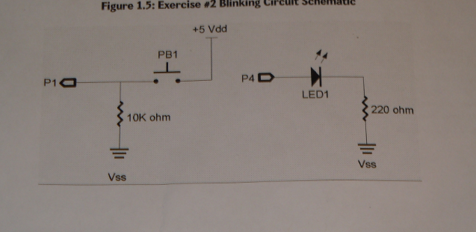
BASICSTAMP II BOARD SETUP:
Pushbutton
Output Pin
Input Pin
Resistors

Slide 47
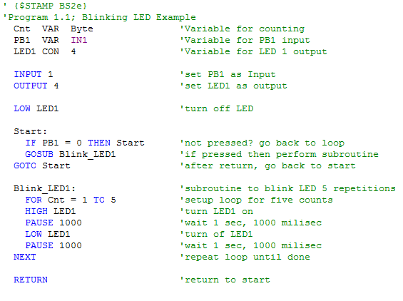
Blinking led PROGRAM FILE:
Define variables
Define Pins
KEY:
Green Text = Comments, A description of each line of code
Blue Text = Commands, A specified word for the BASICSTAMP program to perform a certain function.
Black Text = Titles of variables and routines in the program.
Initial Conditions
INITIAL LOOP
BLINK LED LOOP
Go back to 1st loop

Slide 48
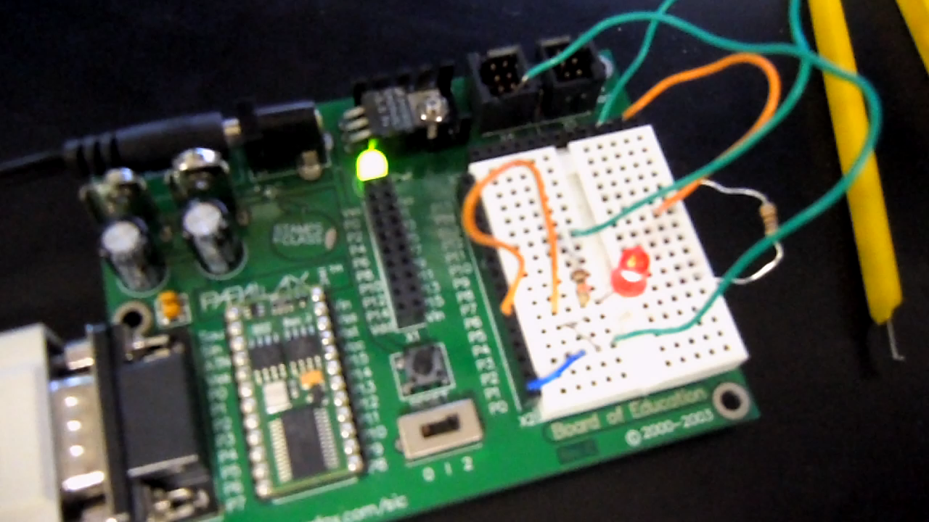
BLINKING LED RESULT:
In The short video clip, it is demonstrated that the LED will blink like it was programed to do.
CONCLUSION: Plainly stated,
BASICSTAMP IS AWESOME!!
Also by using the simple commands of BASICSTAMP a simple PLD it is possible to create a working circuit which responds to various Inputs and functions.

Slide 49
Lab # 6: Basic stamp 2 temp sensor/heater

Slide 50
EQUIPMENT:
Industrial Control Student Workbook Version 1.1
BASICSTAMP II device
BASICSTAMP program
1 10K Potentiometer (Variable Resistor), VR
1 uF Capacitor
1 red LED
2 22o ohm resistors
1 10k ohm resistor
Small flat – headed screwdriver(to adjust variable resistor)
Assorted Wiring
OBJECTIVE:
TO Combine the understanding of a digital program and outputs with that of an ANALOG input and to use the DEBUG process to display the effects.

Slide 51
PROCEDURE:
In the Industrial Control Student Workbook Version 1.1, instructions for Experiment #1, Exercise #3, Analog Data Input, were located.
A program was Composed to simulate the process of a Heater Control, using an RC network with a capacitor and potentiometer.
The temperature was represented by the Potentiometer (Variable Resistor) and could be increased or decreased using a small flat-headed screwdriver to precisely turn the variable screw on top of the resistor. This “heat” was monitored and the heater was energized (RED LED ON) below 100 degrees and de-energized (RED LED OFF) above 120 degrees. The Debug window was used to display the temperature and status of the heater.

Slide 52
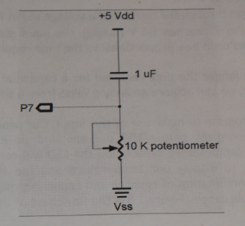
Basicstamp II board setup:
Output Pin
Capacitor
Input Pin
Variable Resistor

Slide 53
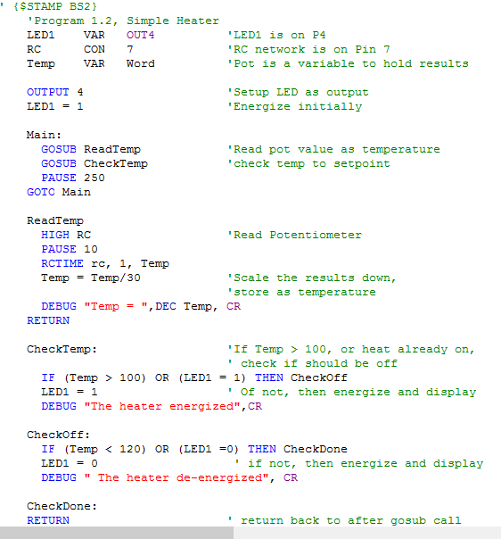
Temp sensor/heater Program:
Define variables
Define Pins
And Initial Conditions
MAIN LOOP
KEY:
Green Text = Comments, A description of each line of code
Blue Text = Commands, A specified word for the BASICSTAMP program to perform a certain function.
Black Text = Titles of variables and routines in the program.
Red Text = Debug command.
READ VR
Initialize DEBUG
IF VR is Low enough
Turn ON heater
IF VR HIGH enough
Turn OFF heater
Go Back to MAIN LOOP

Slide 54
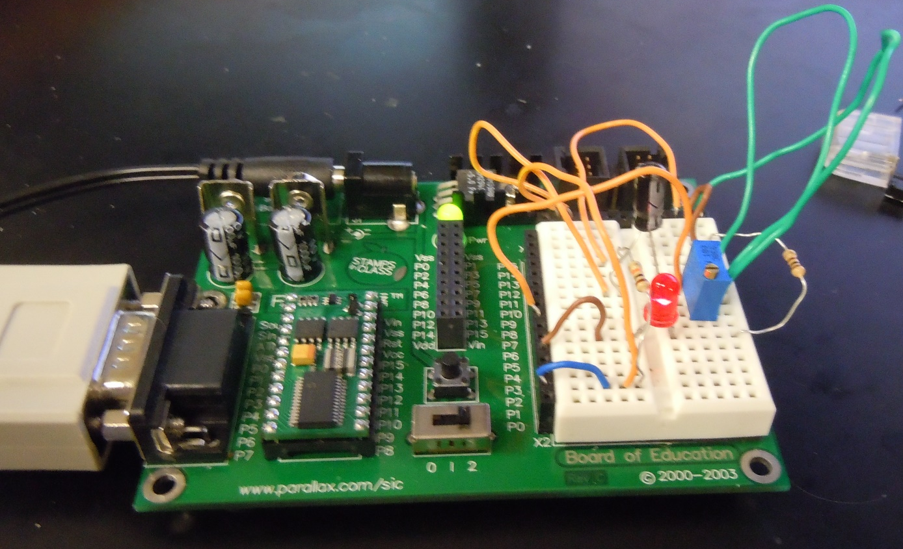
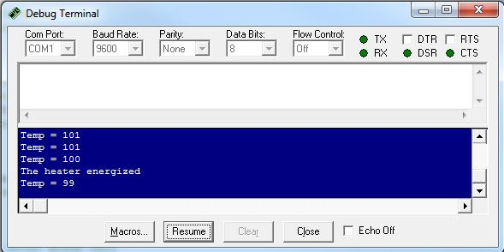
RESULTS, HEATER ENERGIZED:
LEFT: BASICSTAMP while running the program and while the heater was ON.
BELOW: DEBUG screen feedback located on the computer screen. It displays the point and temperature at which the heater was energized.
HEATER
(Energized)
POTENTIAOMETER (VR)

Slide 55
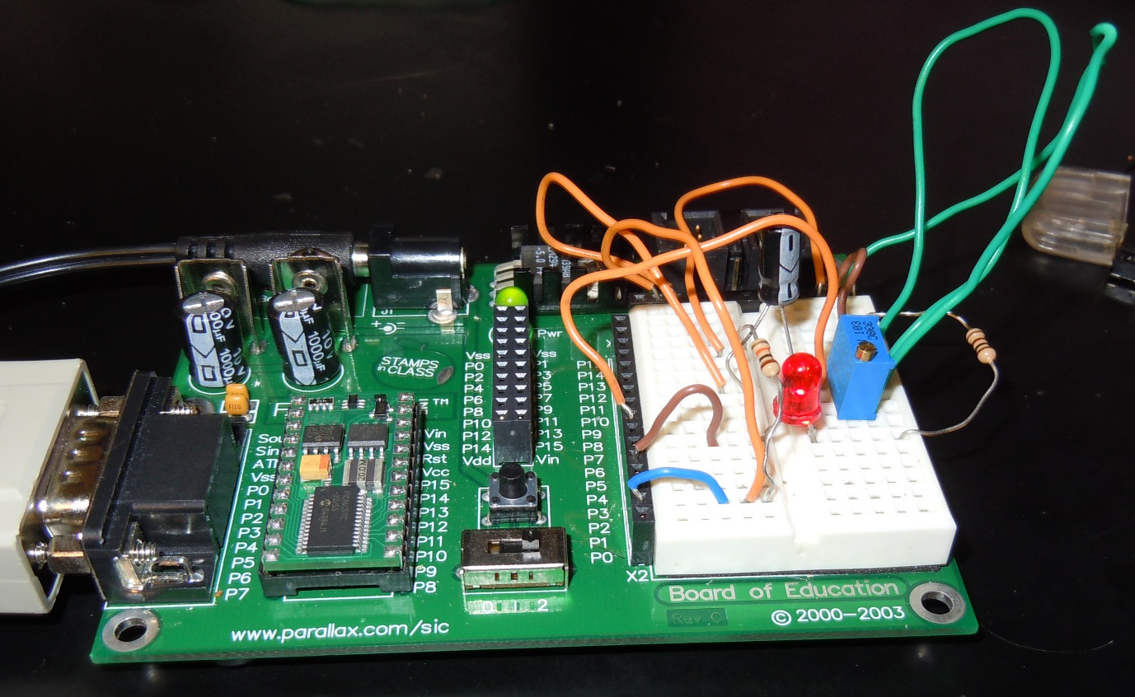
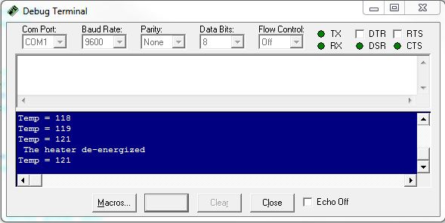
RESULTS, HEATER DE-ENERGIZED:
LEFT: BASICSTAMP while running the program and while the heater was OFF.
BELOW: DEBUG screen feedback located on the computer screen. It displays the point and temperature at which the heater was DE-Energized.
HEATER
(DE-Energized)
POTENTIAOMETER (VR)

Slide 56
CONCLUSION:
By adding the Variable resistor, The result of the program could be determined entirely from the analog change of the Resistor.
The DEBUG sequence makes it possible for differentiating between analog inputs (VR) and digital outputs (LED).

